Slide 1

CSE299 · SECTION 10 · TEAM NEXUS
Sprint 4 Weekly Project Review
Backend, Microservices, and CI/CD — Wired and Verified
SPRINT SNAPSHOT
Window: Aug 4 – 10, 2026 | Status: In Progress · 70% | Priority: High | Duration: 1 week
Jihanur Rahman Ratul (Jihan)
Tahsin Ahmed Sufol
Backend, ML Microservice & CI/CD
Backend Review & Integration Support
Prepared for ITN Sir · CareerSetu — NSU Alumni-Industry Bridge Platform

Slide 2
PROJECT OVERVIEW
CareerSetu, at a Glance
Four sprints in, CareerSetu’s 10-page Next.js frontend now has a real FastAPI backend behind it — not just mock data on localhost.
A separate ML microservice scores CVs and flags job-listing fraud risk, wired into the main API through a proxy route with a safe fallback.
This report covers Sprint 4 (Aug 4 – 10) and previews Sprint 5, next up: wiring the live frontend to these new endpoints.
SPRINT-BY-SPRINT STATUS
Sprint 1
100%
Completed
Jul 6 – 13
Data collection: NSU alumni & company datasets
Sprint 2
100%
Completed
Jul 13 – 21
Repository, branching strategy & CI/CD pipeline
Sprint 3
100%
Completed
Jul 21 – Aug 3
10-page Next.js frontend, fully designed & built
Sprint 4
70%
In Progress
Aug 4 – 10
Backend API, ML microservice & CI/CD integration
CareerSetu | Sprint 4 Weekly Review | CSE299 Sec.10
02 / 14

Slide 3
SPRINT 4 · AUG 4 – 10, 2026
Sprint Goal & Key Deliverables
SPRINT OBJECTIVE
SPRINT META
Build the CareerSetu backend so the frontend can consume real data, enable AI microservice analysis, integrate Convocation and company datasets, and finalize CI/CD automation for the complete platform.
In Progress · 70%
High Priority
Backend
Database
DevOps
KEY DELIVERABLES
Duration
A FastAPI backend with health, alumni (19th/20th/21st), companies, jobs and ML analysis routes
A separate ML microservice (port 8001) for CV scoring and job-fraud trust classification, reached through a proxy route with built-in fallback
A real data loader pulling convocation & company records from CSV files, plus a seed module for frontend-aligned job postings
GitHub Actions running Python tests, a frontend build, and Docker Compose integration smoke tests end-to-end
1 week planned — work continued past the window to finish backend integration
Owner
Jihanur Rahman Ratul (lead) — backend & ML integration, reviewed with Tahsin Ahmed Sufol
Files Shipped
4 new routers, 3 new services, ml_main.py, Dockerfile, docker-compose.yml, CI workflow & SPRINT4.md
CareerSetu | Sprint 4 Weekly Review | CSE299 Sec.10
03 / 14

Slide 4




WEEKLY PROGRESS
How the Sprint Unfolded
Aug 2
Jihan checks progress on frontend and backend, and asks Tahsin to review main and open a PR — the CI/CD pipeline merges automatically once checks pass.
HOW WE TRACK PROGRESS
Slack (#299) still handles day-to-day coordination, but this sprint’s thread stayed short — a handful of check-ins rather than a detailed log.
Aug 2
Tahsin acknowledges: “okay bro.”
Aug 9
The Notion Sprint Tracker and this SPRINT4.md report remain the source of truth for what actually shipped — objectives, completion % and retrospectives, reported here each week.
Jihan reports the frontend is essentially done and pivots the thread to backend status — asking Tahsin to help integrate the ML/AI microservices and the database.
Aug 14
Tahsin’s last word in the thread: “Okay bro.” — the Slack log goes quiet from here.
Since
The FastAPI backend, ML microservice, data loader and a green CI/CD pipeline all land on main — documented in SPRINT4.md.
CareerSetu | Sprint 4 Weekly Review | CSE299 Sec.10
04 / 14

Slide 5
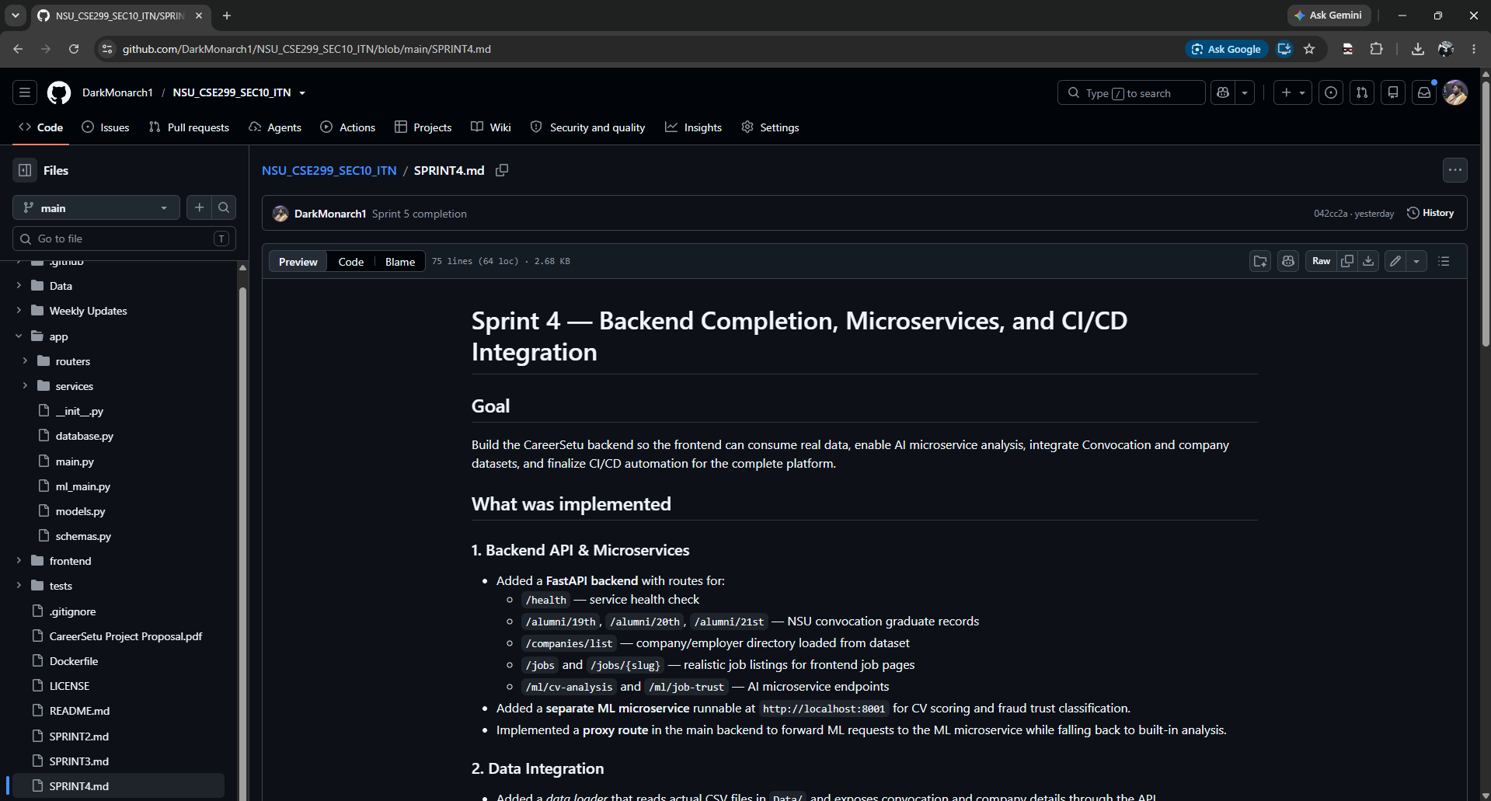
EVIDENCE · 1 OF 5
Backend API & Microservices
github.com/DarkMonarch1/NSU_CSE299_SEC10_ITN — SPRINT4.md
A FastAPI backend now exposes /health, /alumni/19th|20th|21st, /companies/list, /jobs, /jobs/{slug}, /ml/cv-analysis and /ml/job-trust
A separate ML microservice runs on its own port (8001) for CV scoring and job-fraud trust classification
A proxy route in the main backend forwards ML requests to that microservice, and falls back to built-in analysis if it's unreachable
The whole surface is documented directly in SPRINT4.md, alongside setup and run instructions
CareerSetu | Sprint 4 Weekly Review | CSE299 Sec.10
05 / 14

Slide 6
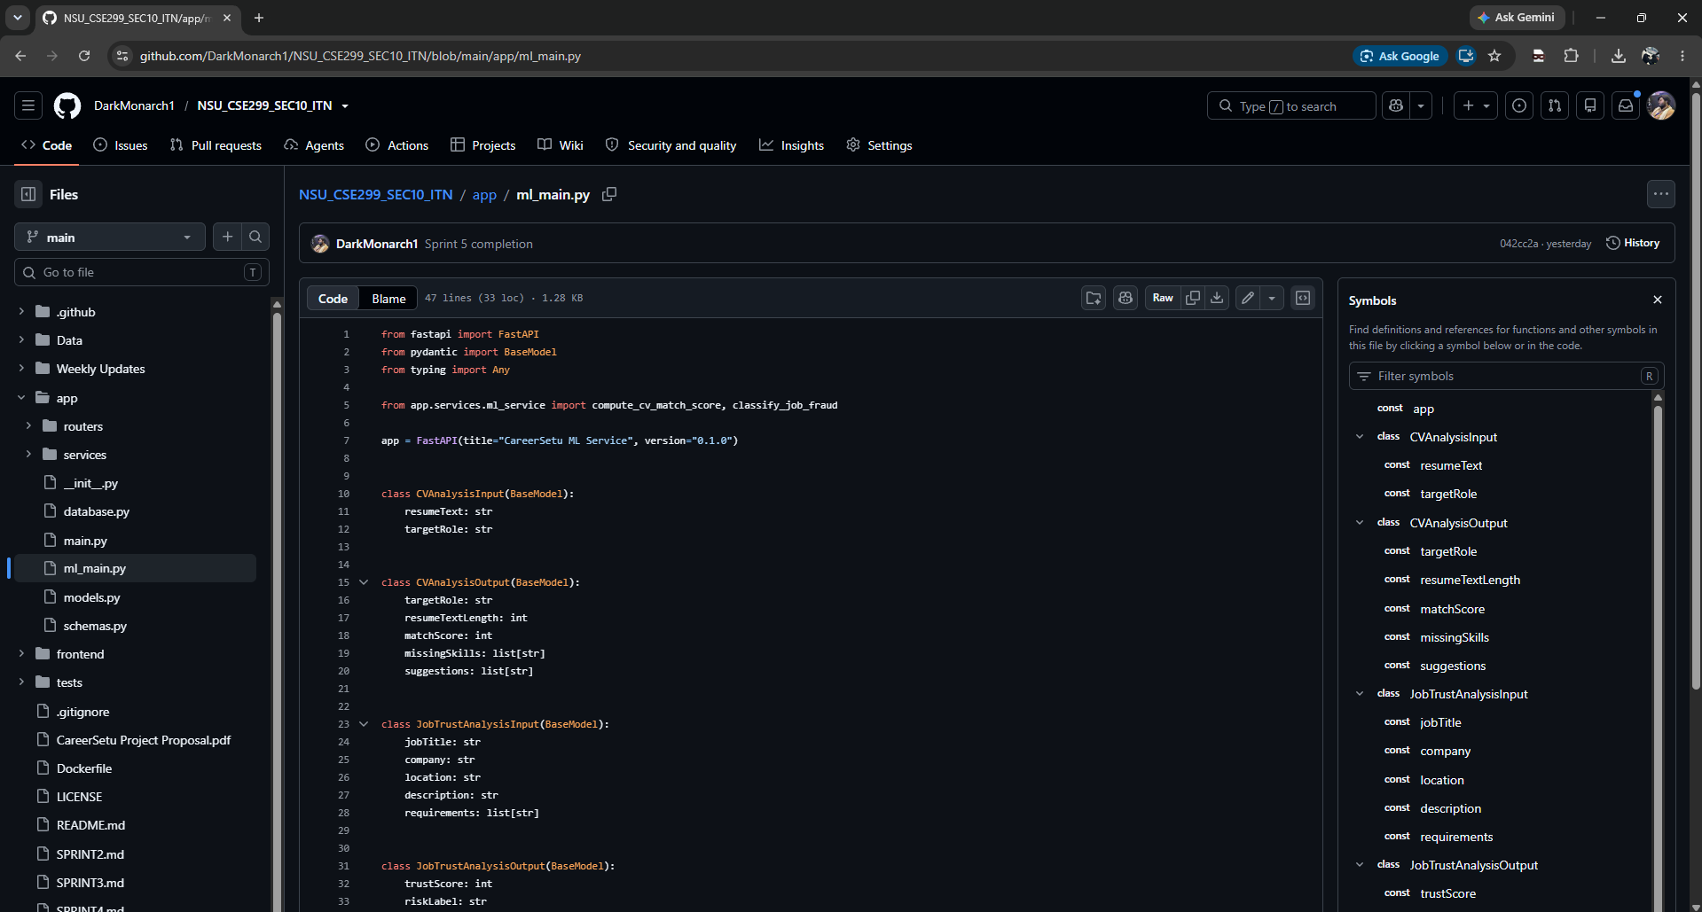
EVIDENCE · 2 OF 5
Inside the ML Microservice
NSU_CSE299_SEC10_ITN/app/ml_main.py
A standalone FastAPI app (“CareerSetu ML Service”), separate from the main backend so it can run, fail, or scale independently
CVAnalysisInput/Output models score a resume against a target role: match score, missing skills and improvement suggestions
JobTrustAnalysisInput/Output models power /ml/job-trust: a trust score and a risk label for every job listing
Both schemas are typed with Pydantic, keeping the contract explicit between the ML service and the main API
CareerSetu | Sprint 4 Weekly Review | CSE299 Sec.10
06 / 14

Slide 7
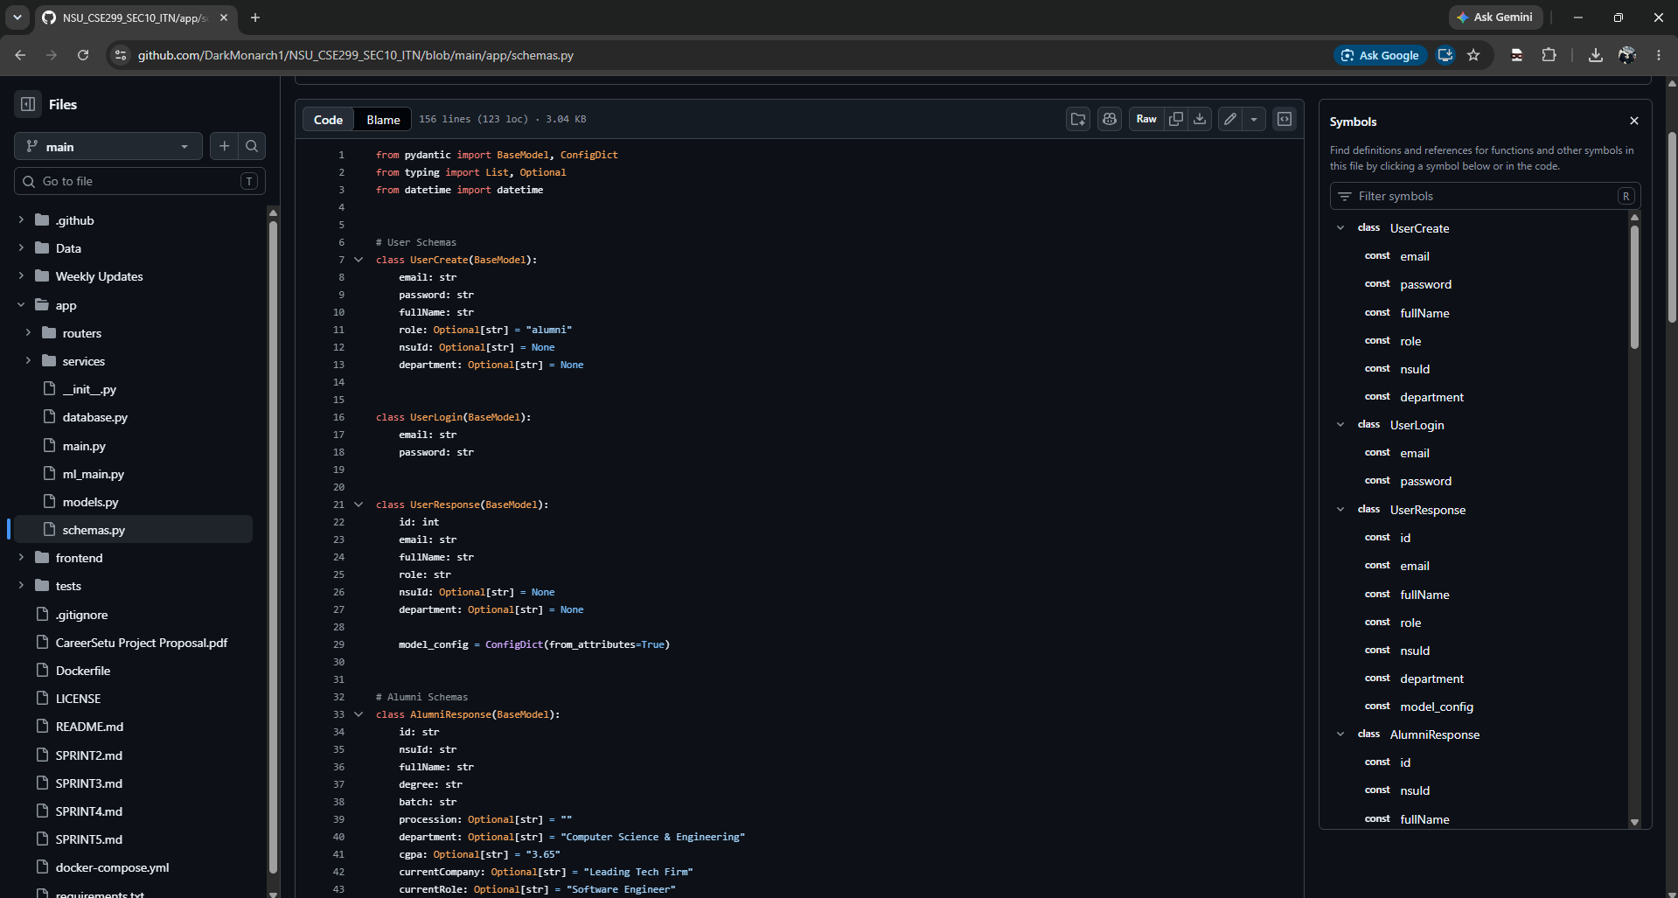
EVIDENCE · 3 OF 5
Data Models Behind Every Page
NSU_CSE299_SEC10_ITN/app/schemas.py
UserCreate, UserLogin and UserResponse schemas back real authentication — no more mock login state on the frontend
AlumniResponse mirrors the frontend's alumni cards: NSU ID, degree, batch, procession, department, CGPA, current company & role
156 lines of typed Pydantic models keep the API contract aligned with the TypeScript types built back in Sprint 3
Sensible defaults (department, CGPA, company) keep records realistic while more real data is still being loaded in
CareerSetu | Sprint 4 Weekly Review | CSE299 Sec.10
07 / 14

Slide 8
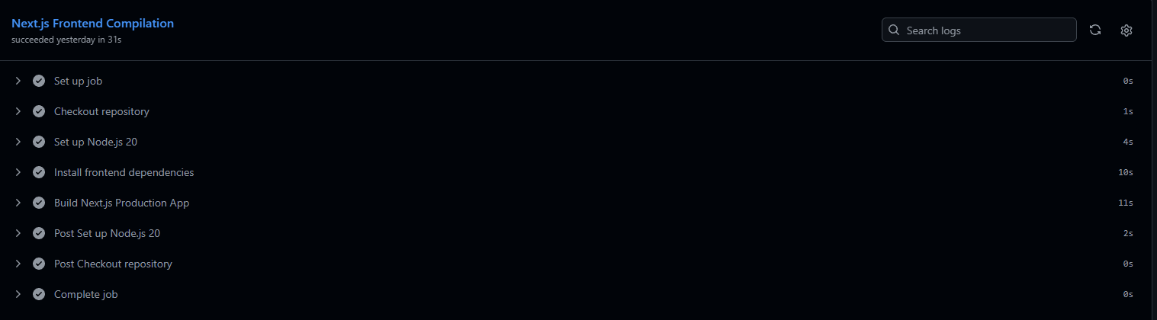
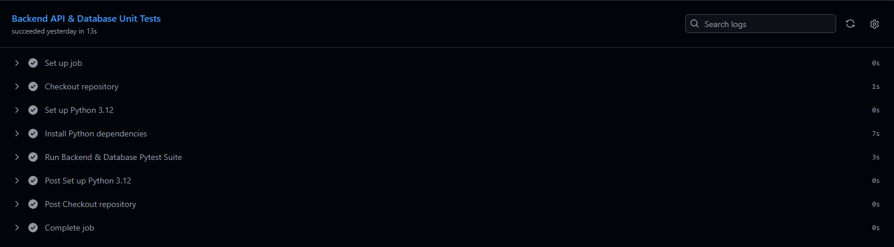
EVIDENCE · 4 OF 5
CI/CD Pipeline — All Green
GitHub Actions — NSU_CSE299_SEC10_ITN
GitHub Actions now runs two jobs on every push: Next.js frontend compilation and a backend/database Pytest suite
Frontend build succeeds in 31s; backend & database unit tests succeed in 13s
Docker Compose integration smoke-tests both services together, mirroring a local docker compose up --build
The pipeline first added in Sprint 2 now covers backend and ML service code, not just the frontend
Next.js Frontend Compilation — 31s
Backend API & Database Unit Tests — 13s
CareerSetu | Sprint 4 Weekly Review | CSE299 Sec.10
08 / 14

Slide 9
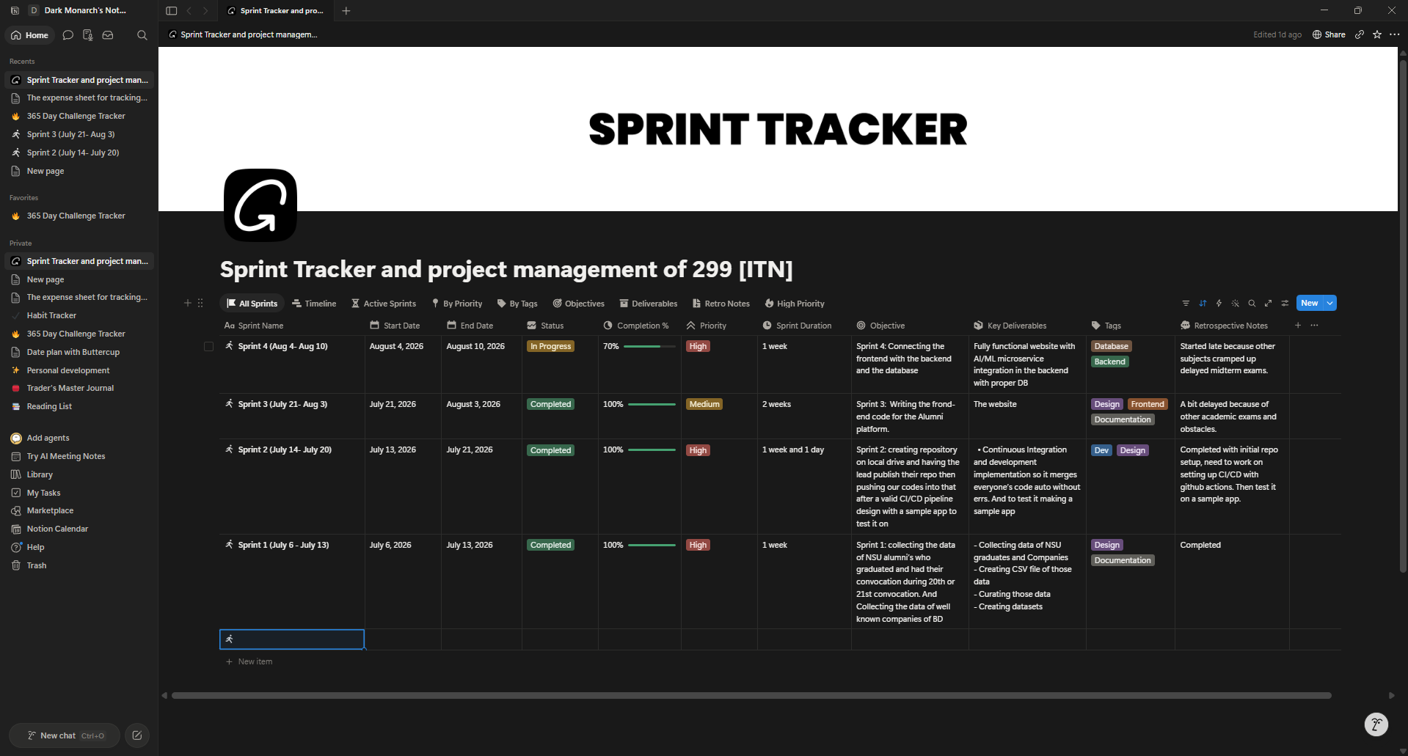
EVIDENCE · 5 OF 5
Sprint Tracking in Notion
Notion — Sprint Tracker (299 [ITN])
Sprint 4 (Aug 4 – 10) is logged at 70% In Progress, High priority, across a 1-week window
Retrospective notes stay candid: the sprint started late — other coursework and midterm exams cramped the schedule
Deliverables tie straight to backend work: AI/ML microservice integration with a proper database, tagged Database / Backend
The same tracker that logged three straight 100% sprints keeps this one honest about the slip
CareerSetu | Sprint 4 Weekly Review | CSE299 Sec.10
09 / 14

Slide 10
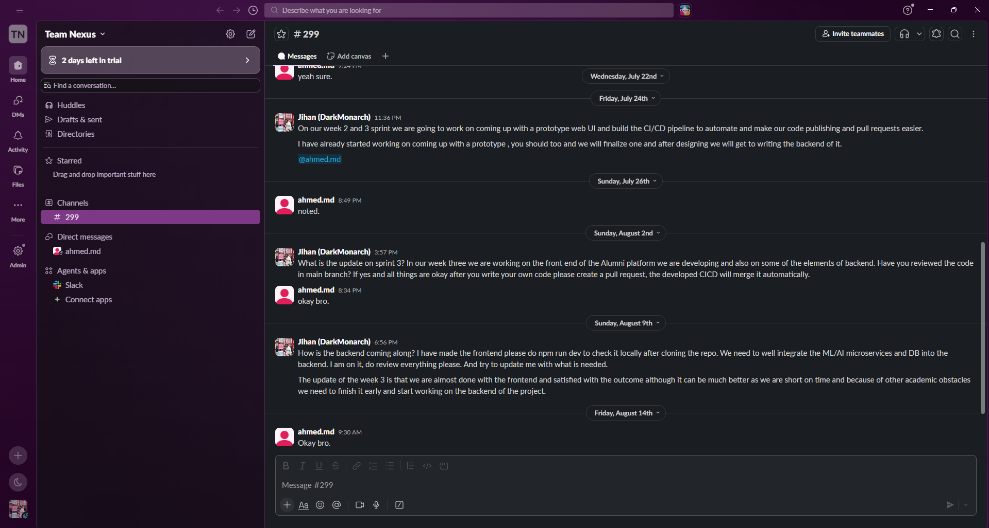
COMMUNICATION REVIEW
Team Communication — Slack
Slack — Team Nexus / #299
The same #299 thread carries Sprint 4's coordination — noticeably shorter and quieter than Sprint 3's
Aug 2: Jihan checks frontend/backend progress and asks for a review + PR before merging; Tahsin acknowledges
Aug 9: Jihan flags backend and DB status directly, asking Tahsin to help wire in the ML/AI microservices; confirms the frontend is effectively done
Aug 14: Tahsin's last update in the thread is a brief “Okay bro.” — most of the actual backend work landed in commits, not chat
CareerSetu | Sprint 4 Weekly Review | CSE299 Sec.10
10 / 14

Slide 11
RISK MANAGEMENT
Risks & Issues
Risk | Likelihood | Impact | Mitigation
Sprint 4 slipped past its Aug 10 deadline — still 70% in the tracker as of this report | High | High | Scope the remaining frontend-wiring work into Sprint 5 rather than extending Sprint 4 further
Only the lead (DarkMonarch1) has authored the backend, ML service and CI/CD commits | High | Medium | Carry the Sprint 3 mitigation forward — assign Tahsin concrete backend tickets, not just review
Academic exams have now delayed three sprints in a row | High | Medium | Keep Sprint 4/5 marked High priority, with daily Slack syncs until the backend catches up
Notion tracker (70%) and the shipped code (fully documented, CI green) disagree on completion | Medium | Low | Update the tracker to match SPRINT4.md before Sprint 5 kicks off
Two risks carried since Sprint 3 — single contributor, exam overlap — are now three sprints running. They're tracked, not hidden.
CareerSetu | Sprint 4 Weekly Review | CSE299 Sec.10
11 / 14

Slide 12


RETROSPECTIVE
What Went Well, What We're Improving
WENT WELL
TO IMPROVE
FastAPI backend fully wired: health, alumni, companies, jobs and ML routes all live
A genuinely separate ML microservice, reachable through a proxy with a safe fallback
Real data loader replaces static mocks with actual convocation & company CSVs
CI/CD now tests backend and frontend together via Docker Compose, not just the frontend
Sprint slipped past its window again — Notion still shows 70% though the code is essentially complete
Tahsin's involvement stayed at acknowledgment level (“okay bro”) rather than authored commits
Frontend still runs on mock data day-to-day; wiring it to these new endpoints is now the critical path
70%
Sprint 4 completion (per tracker) — backend, ML microservice and CI/CD shipped and verified; frontend wiring carries into Sprint 5.
CareerSetu | Sprint 4 Weekly Review | CSE299 Sec.10
12 / 14

Slide 13

LOOKING AHEAD · SPRINT 5
Next Sprint: Connecting Frontend to Live Data
SPRINT 5 OBJECTIVE
Connect the frontend to these API endpoints and replace mock dataset imports with live HTTP requests.
DELIVERABLE & META
Key Deliverable:
Every page — alumni, jobs, companies, CV grooming, job-trust — reading from the real FastAPI + ML backend instead of static mock data.
Sprint 4 delivered its full documented scope, but slipped past the Aug 10 window. Sprint 5 inherits both the frontend-wiring work and the discipline of getting Tahsin actively committing code, not just reviewing it.
Contributors:
Jihanur Rahman Ratul & Tahsin Ahmed Sufol
High
Frontend / Integration
Priority:
Tags:
CareerSetu | Sprint 4 Weekly Review | CSE299 Sec.10
13 / 14

Slide 14

Thank You
We welcome your feedback, ITN Sir
SCORING RUBRIC & OPEN QUESTIONS
Is the backend and ML microservice architecture at the depth you’d expect before frontend integration, and does treating Sprint 5 as “connect the dots” match the scope you’d want to see for the time remaining?
CSE299 · North South University · Section 10 · Team Nexus

